Slide 1
THE GREEN DEAL
Alan Lupton

Slide 2
THE STORY SO FAR
1996 Introduction of the Home Energy Conservation Act (HECA) – local authorities to report annually on the reduction of CO2 from domestic properties.
2002 – 2005 Energy Efficiency Commitment 1 (EEC1) – government obligation on the big 6 power suppliers to cut CO2 emissions from the domestic sector.
2005 – 2008 Energy Efficiency Commitment 2 (EEC2) – extension of EEC1 with requirements for even bigger cuts in emissions.
2008 – 2011 Carbon Emissions Reduction Commitment (CERT) – very similar to EEC1 and 2 but the obligation is now extended to the large generators of electricity as well as the big 6 suppliers.
2011 – 2012 Carbon Emissions Reduction Commitment (Extension) – CERT extension with increased focus on insulation measures.

Slide 3
AND A FEW OTHER THINGS
Home Energy Efficiency Scheme (HEES) – introduced in June 2000 to provide “free” insulation and heating measures to “vulnerable” households.
Warm Front Scheme – replaced HEES in 2005 and now run nationally by Eaga (recently taken over by Carillion).
Social Housing Energy Saving Programme (SHESP) – launched in 2009 government funded scheme to help insulate “hard to treat” properties in the social sector.
Community Energy Saving Programme (CESP) - £350m government programme to provide an “area based approach” to whole house upgrades in areas of high deprivation.
Building Regulations – ongoing changes to improve the fabric of new builds
Code for Sustainable Homes

Slide 4
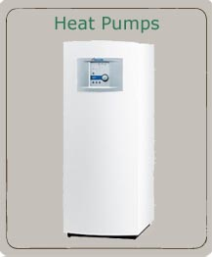
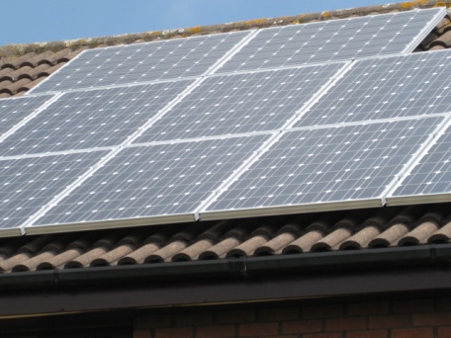



WHERE DO WE GO FROM HERE?
FEED IN TARIFFS
RENEWABLE HEAT INCENTIVE
THE GREEN DEAL
Cavity Wall Insulation
Loft Insulation
Solid Wall Insulation

Slide 5
What is the Green Deal?
A market-led mechanism, funded by private capital
Energy efficiency improvements at no upfront cost
Marketing
and
Consumer Demand
Assessment
/ advice
Finance
Installation
Repayments and Follow-up
Notes:
5

Slide 6
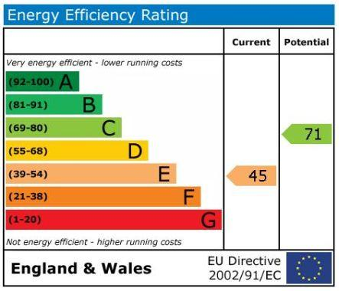
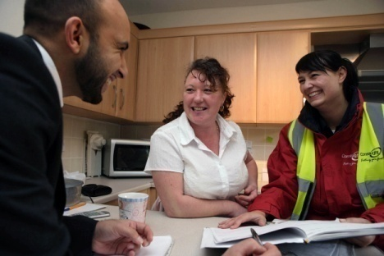
The Green Deal Process (1)
Marketing
and
Consumer Demand
Assessment
/ advice
Finance
Installation
Repayments and Follow-up

Slide 7

The Green Deal Process (2)
Marketing
and
Consumer Demand
Assessment
/ advice
Finance
Installation
Repayments and Follow-up
No upfront cost
Repayments attached to energy meter

Slide 8
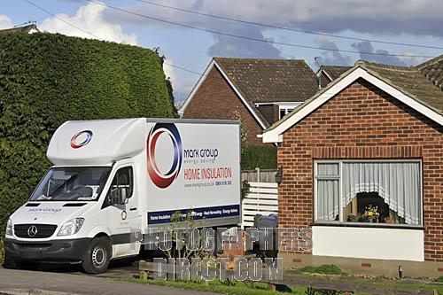
The Green Deal Process (3)
Marketing
and
Consumer Demand
Assessment
/ advice
Finance
Installation
Repayments and Follow-up
Accredited installation
Product certification
Codes of practice
Quality mark

Slide 9
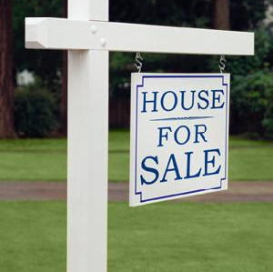



Green Deal: Repayments
Repay via meter over up to 25 years
THE GOLDEN RULE
The savings on energy bills as a result of the measures
installed are expected to exceed the repayment costs.

Slide 10
Green Deal Measures
Heating, Ventilation & Air Conditioning: Condensing Boilers, Heating Controls, Under Floor Heating, Heat Recovery Systems, Mechanical Ventilation (Non domestic), Flue Gas Recovery Devices.
Building Fabric: Cavity Wall Insulation, Loft Insulation, Flat Roof Insulation, Internal Wall Insulation, External Wall Insulation, Draught Proofing, Floor Insulation, Heating system insulation (cylinders, pipes), Energy efficient glazing and doors
Lighting: Lighting Fittings, Lighting Controls
Water Heating: Innovative hot water systems, Water efficient taps and showers
Microgeneration: Ground & Air Source Heat Pumps, Solar Thermal, Solar PV, Biomass Boilers, Micro CHP

Slide 11
The future Energy Company Obligation
ECO is an obligation on the energy suppliers to support household energy efficiency
Builds on strengths of existing CERT and CESP schemes
Designed to fit with the Green Deal landscape
Will commence at end of 2012
But NO firm details as yet?

Slide 12
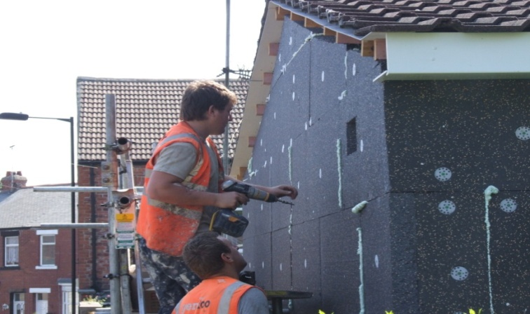
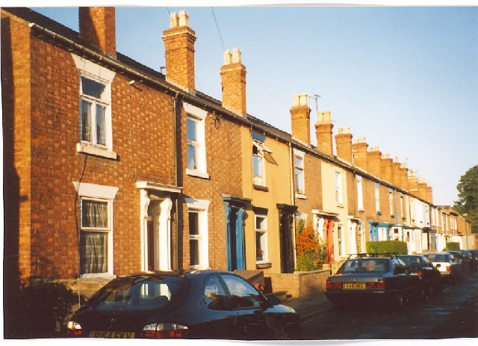
The role of the ECO
There will be households for whom Green Deal finance is not suitable as they might take the benefit of the measures in improved comfort rather than financial savings
ECO to integrate with the Green Deal, with a focus on:
  hard to treat properties; and
  vulnerable and poor households

Slide 13
The role/s of communities?
Broad models:
Supporting community wide roll out of Green Deal?
Partnering with councils &/or Green Deal Providers to support delivery?
Engaging with local residents to promote energy efficiency improvements?

Slide 14
Timetable for Green Deal & ECO Legislation
DATE | MILESTONE
December 2010 | Introduction of the Energy Bill to Parliament
Pre- Autumn 2011 | Officials engage stakeholders as they develop the technical details for secondary legislation
Autumn 2011 | Formal consultation on secondary legislation
Early 2012 | Secondary legislation laid before Parliament
Spring 2012 | Detailed industry guidance prepared
Autumn 2012 | First Green Deals appear & ECO in force
.

Slide 15
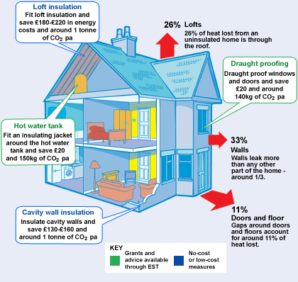
ANY QUESTIONS

Slide 16
CONTACT DETAILS
ALAN LUPTON
HOUSING PROJECT OFFICER
4 CIVIC WAY
ELLESMERE PORT
CHESHIRE
CH65 0BE
TEL No: 0151 356 6953
Email: alan.lupton@cheshirewestandchester.gov.uk

